Slide 1

Watch Video
Call : +91 9629754500
Email: contact@codeshoppy.com

Slide 2
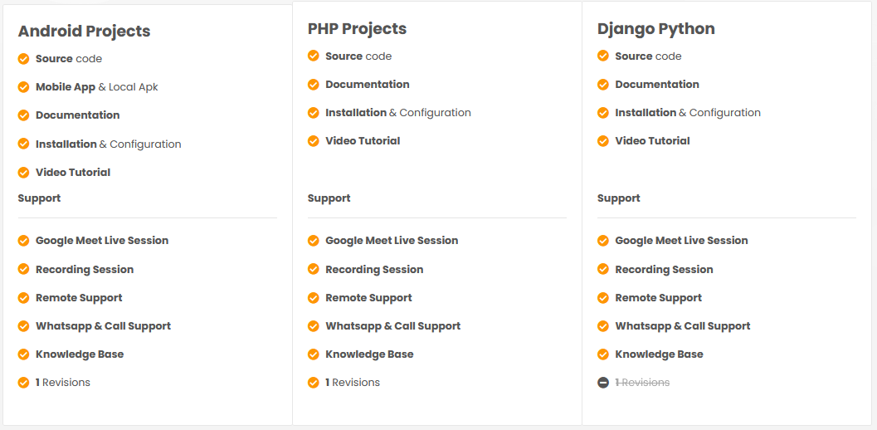

Slide 3
WOMEN SECURITY APPLICATION

Slide 4
AIM OF THE PROJECT
In today’s world, people using smart phones have increased rapidly and hence, a smart phone can be used efficiently for personal security or various other protection purposes.
The heinous incident that outraged the entire nation have waken us to go for the safety issues and so a host of new apps have been developed to provide security systems to women via their phones.
This Application for the Safety of Women and this app can be activated this app by a single click, whenever need arises.
A single click on this app identifies the location of place through GOOGLE GEO LOCATION and sends a SMS message comprising this location to the registered contacts and also call on the first registered contact to help the one in dangerous situations.

Slide 5
OBJECTIVE OF THIS PROJECT
As an independent nation, we must ensure respect and security of women and we cannot deny them this basic right.
It is now time to initiate action to eradicate the menace of security issues with women.
Violence against women remains embedded in our societies, both as a daily reality and a difficult situations
Comparing to existing computerized system, our system is gives more security and also System gives better user friendly environment for the users.
When she press sos button the mobile this system will sends message to the all nearby cells which having that application.
This system also send message to graudian . Also our system sends alert message to graudian .

Slide 6

SOFTWARE AND HARDWARE REQUIREMENTS
HARDWARE REQUIREMENTS:
Processor : intel 3
Motherboard : intel 915gvsr chipset board
Ram : 4 gb ddr2 ram
Hard disk drive : 160 gb
SOFTWARE REQUIREMENTS:
Front end : html5, css3, bootstrap
Back end : php, mysql
Control end : angular java script
PHP TOOLS:
xampp-win32-5.5.19-0-VC11
ANDROID TOOLS:
Android Emulator
xampp-win32-5.5.19-0-VC11
Android Studio

Slide 7
EXISTING SYSTEM
The existing system is the manual system. Need to be converted into automated system.
The women have to dial a number to call a police or send SMS to the particular subscribed code.
After they received the service they will get in touch with you later and there is no time to make a call or SMS.
There are also so many volunteer organizations all over the world to help them, but they could not able to get those messages.

Slide 8
DISADVANTAGES OF EXISTING SYSTEM
Lack of privacy​
Risk in the management of the data.​
Less Security​
Low co-ordination between ​
Less User-friendly​
Accuracy not guaranteed​
Not in reach of distant users.
There is no storage and automation if users have some enquiry.

Slide 9
PROPOSED SYSTEM
We will be tracking the location of the person via GPS and storing the details of the current location into a remote server via GPRs consecutively.
We will also be tracking the schedule of the person as per the schedule list which is being uploaded by the person
And we will be sending SMS to the relatives of the concerned persons about the schedule their current location of the concerned person that time.
So that they will come to know about the status and if something is wrong, we will be having another set of oppositions to give a call to police, social workers, volunteer organizations, etc.

Slide 10
ADVANTAGES OF PROPOSED SYSTEM
The Project has several features and easy to manage.
1. The System is user friendly.
2. Cost effective.
3. Back up support.
4. Secured Data.
5. Helpful for women security

Slide 11
MODULE LIST
USER
Registration
Login
Update Geo location
SOS Button - For emergency
SMS Alert to guardian
Add Guardian - Email & Mobile No
Manage Guardian

Slide 12
MODULE LIST
ADMIN
Register
Manage App
View location information

Slide 13
USECASE DIAGRAMS
USER AND ADMIN

Slide 14
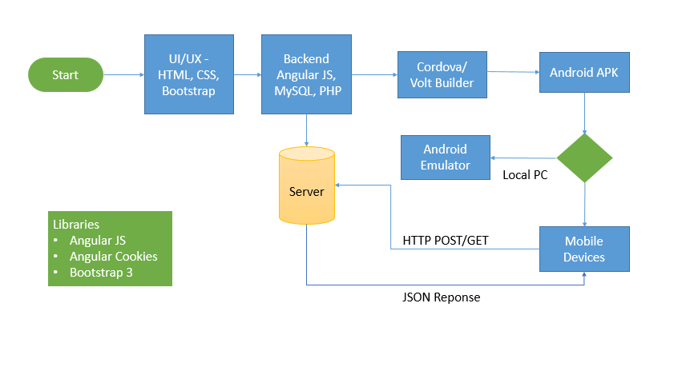
WORK FLOW DIAGRAM FOR ANDROID

Slide 15
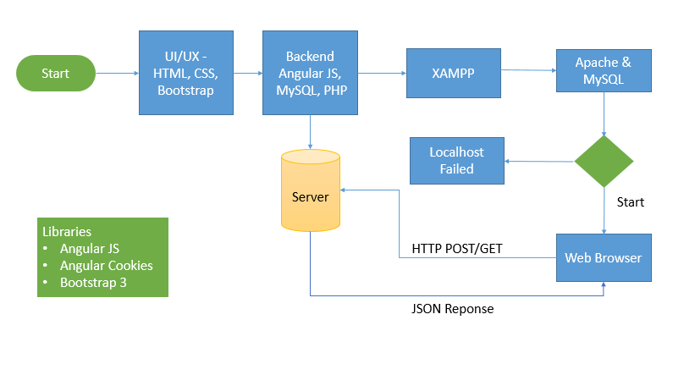
WORK FLOW DIAGRAM FOR WEB APPLICATION

Slide 16
CONCLUSION
This is the “Android Application for women security system” which is very useful application mainly for girl’s safety. We can send our location to our family members and police stations by shaking mobile.
Also system sends messages to nearby peoples who are all having this app.
Overall system work for the safety of the women.
This system will send message to the all nearby cells which having that application.
This system also send message to police station

Slide 17
FUTURE ENHANCEMENT
In Future work, This application to develop a cross platforms like IOS, etc.
In adding the more features of women security management system to develop access with user’s flexibility.
To authenticate the users based on the system users list which is maintained by the operating system
To restrict the usage of all files by the users based on their privileges on the system

Slide 18
REFERNECES
www.mysql.com
http://en.wikipedia.org/wiki/Recruitment
www.w3schools.com
www.google.co.in
http://www.recruitmentsystems.com
http://www.codeproject.com/KB/architecture/OOP_Concepts_and_¬ manymore.aspx
http://en.wikipedia.org/wiki/Human_resource_management
http://en.wikipedia.org/wiki/Object-oriented_programming
https://www.iosrjournals.org/iosr-jce/papers/Vol17-issue3/Version-4/A017340104.pdf

